Slide 1
Process Change Request
Flow Process Draft
Background
PCR Before After Summary
Proposed Flow Process
Timeline
Important Concerns
0
Notes:
Background :
1) History Long L.T of FR6F Approval
2) Related to Process Change Business Process and Procedure belong to PE
3) Control and Monitoring regarding fulfillment PCR requirement coordinated by PE and supported by QC

Slide 2
1. Background
Change business flow from Internal Niterra Indonesia to Customer OEM/OES
Current Condition
KD Parts PCR
Passthrough PCR
Customers
PE
Sales OE
Procurement
Quality
Internal PCR
Local Supplier PCR
Passthrough PCR
Customers
Proposed Condition
KD Parts PCR
Internal Review
PE
Procurement
Quality
Local Supplier PCR
Internal PCR
Current Condition : Passthrough & Customer PCR activity lead by Sales OE
Proposed Condition : Passthrough & Customer PCR activity lead by PE, Internal Review : Localization & Customer Approval Need review lead by PE. For Localization Request will submit to GHQ by PE or Sales Marketing.

Slide 3
2. PCR Before After Summary
Step |  | Before | After | Remark
Input | Item | External : K/D, Passthrough, Supplier Internal : Niterra INA | External : K/D, Passthrough, Supplier Internal : Niterra INA | Originator Dept are department where item of changes are initially triggered.
 | Change Point | No Localization Stage | Must Pass Localization Stage
Process | Item | Sales, PE, Quality As Window Dept PE & Sales control & monitoring PCR Event | 1) PE as Window Dept 2) PE control & monitoring PCR event 3) QA Support internal documents update | Internal activity controlled by PE
 | Change Point | Passthrough by Sales, Inhouse by PE | PE as Dept window for Overseas communication & PCR event (sales OE acknowledge)
Output | Item | 1) PCR Customer Submission, Feedback & Judgement by Sales OE | 1) PCR Customer Submission, Feedback & Judgement by PE (sales OE acknowledge) 2) PCR Internal Approval | Control & Monitoring by PE
 | Change Point | Sales as Dept window for PCR Submission until PCR Judgement | PE as Dept window for PCR Submission until PCR Judgement (sales OE acknowledge)
Notes:
Background ➔ ada di deskripsi page 1
Before – After simple statement (change point)
➔ Context Coordination & Fulfillment : Before ( Internal Process by PE, External Process By Sales ), After ( Internal & External Process by PE )
3) Tabel Follow Page 3 ➔ Dengan panel review ( PE + DGM + GM ) judgment Lokalisasi di awal sebelum process PCR
4) Job load & countermeasure (if not enough)
➔ Cross check Current Job Load, Cross Check & Simulate with additional PCR Job ( Our current PCR Job + Customer PCR Job in each flow )

Slide 4
3. Proposed Flow Process
Internal Proposed :
From Niterra Indonesia
Supplier
PE Window
Localization Panel
Need
NG
STOP
Overseas PCR Proposed
KD Parts
Passthrough Parts
Localization Sheet
Proposed Localization
Localization Judgement
Received by Niterra Dept
No Need
OK
Need
Customer Submit
Submit PCR to Customer
Customer Feedback & Requirement
Trial & Evaluation
Received by PM or GM MKT
No Need
Internal Requirement List
Internal Requirement List
Customer Judgement
Trial & Evaluation
OK
NG
NG
Internal QM Verification
OK
Mass Production
OK
Intenral QM Verification
1st Delivery
PIC Localization Sheet : Related Manufacturing : PE
Related to Business Administration : Sales Marketing

Slide 5
4.Timeline
No | Item | Lead by | 2025 |  |  |  |  |  |  |  |  | 2026 |  |  | Remark
 |  |  | 4 | 5 | 6 | 7 | 8 | 9 | 10 | 11 | 12 | 1 | 2 | 3
1 | Revise PCR Procedure : Localization Sheet, KD Parts, External, & Passthrough Parts | PE
2 | PCR Procedure Finish : Flow Process, PIC, Scope of Work & Authority | PE
3 | Sharing Knowledge & Training ( Customer BP ): Flow , Communication, Customer PIC : 2W : AHM, YIMM, SIM, KMI 4W : ADM, HPM, SIM, TAM | Sales OE |  |  |  |  |  |  |  |  |  |  |  |  | Introduction Sharing knowledge
4 | Training Passthrough Part : Spark Plug, Sensor Oxygen, Sensor LAF, Sensor Knock | PE |  |  |  |  |  |  |  |  |  |  |  |  | Refer to Training Schedule
5 | Hand Over Transition Phase | Sales OE
6 | PE fully lead PCR | PE
7 | PCR Control Improvement ( Spreadsheet to Portal application ) | PE |  |  |  |  |  |  |  |  |  |  |  |  | Refer to IT Project
8 | PCR Output to Material ( BOM Master Application ) | PE |  |  |  |  |  |  |  |  |  |  |  |  | Refer to IT Project
Rome was not built in a day
Notes:
1 ) July start Job Transfer PCR from Sales.
2) Customer BP, refer to Quality Manual.
3) Paralel untuk perkenalan ke customer 1 hari satu customer ( face to face ), dengan preliminari lewat email

Slide 6
5. Important Concerns
No | Concern/Important Item | Remark
1 | Sales OE will join when PCR meeting with Customer, PE only explain for technical meeting not for business required | -
2 | Due to PCR have limited time, we need to prevent the PCR delay | PCR Panel Review
3 | How to utilize the working ratio in Sales OE when PCR transfer to PE? | -
4 | Current PCR Obstacles Some Overseas (e.g Niterra North America) : too slow respon Niterra Japan : Take Time required documents & lack of PCR information/materials Niterra Indonesia : Lack of monitoring | PCR Panel Review
5 | To monitoring PCR (Supplier/KD Parts → Internal/Oversease → PE → Customer) will use Monitoring Portal like Purchase Request (similar features) | October 2025
6 | Transfer Business Process from Sales OE to PE need to revise : Business Process Procedure Working Instructions | July 2025
7 | PCR Task Transfer transition in June-July and will lead by PE by July | Introduction to Customer, etc and start Lead by PE on July
8 | IE Workload Analysis (additional PCR transfer from Sales OEM to IE) | End of June 2025
9 | Socialization new PCR Procedure to all related Dept | -

Slide 7
Appendix

Slide 8
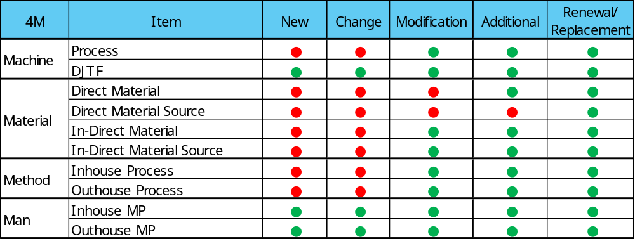
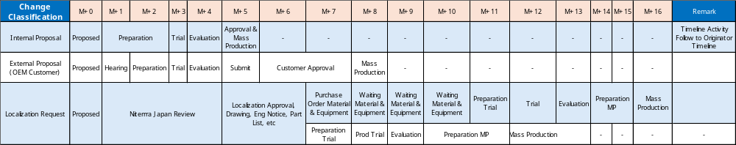
Appendix 2 Classification
PCR Matrix
Red Circle : Need Customer Approval
Green Circle : No Need Customer Approval
Change Classification Lead Time
Based on 3 classification :
Internal Proposal basically follow originator timeline, but better submit when the originator have a plan to change
For External Proposal (OEM Customer) it will take time atleast 8 months but can be advance when we prepared the customer requirements before we submit the proposal
For Localization request that need new material or equipment, it will takes time around 16 months, but if no need order new material or equipment it will take around 12 months
Notes:
1) Tambah keterangan M = moonth

Slide 9
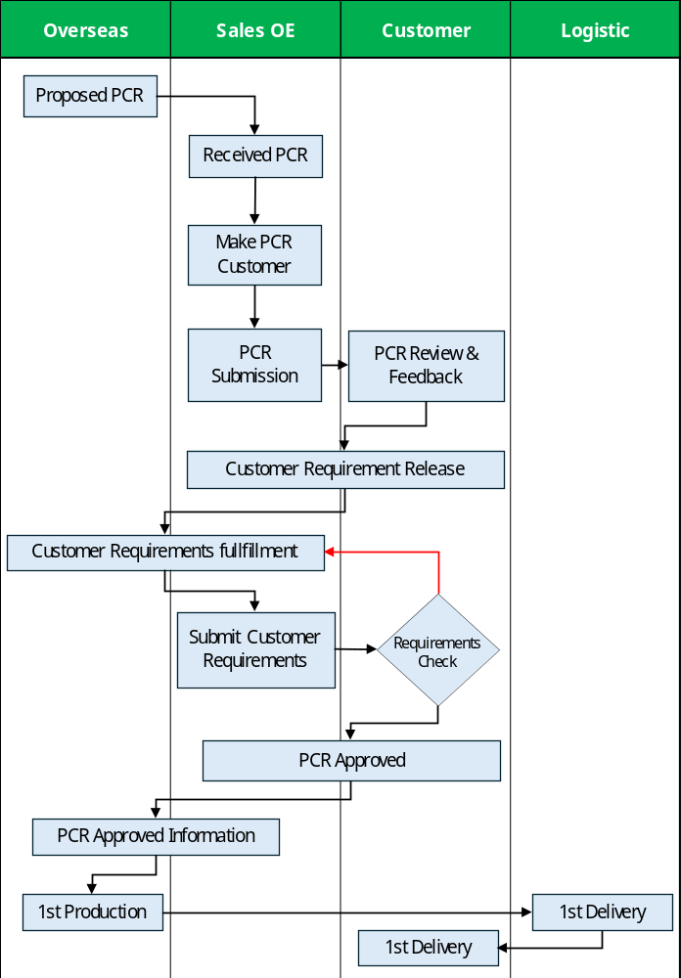
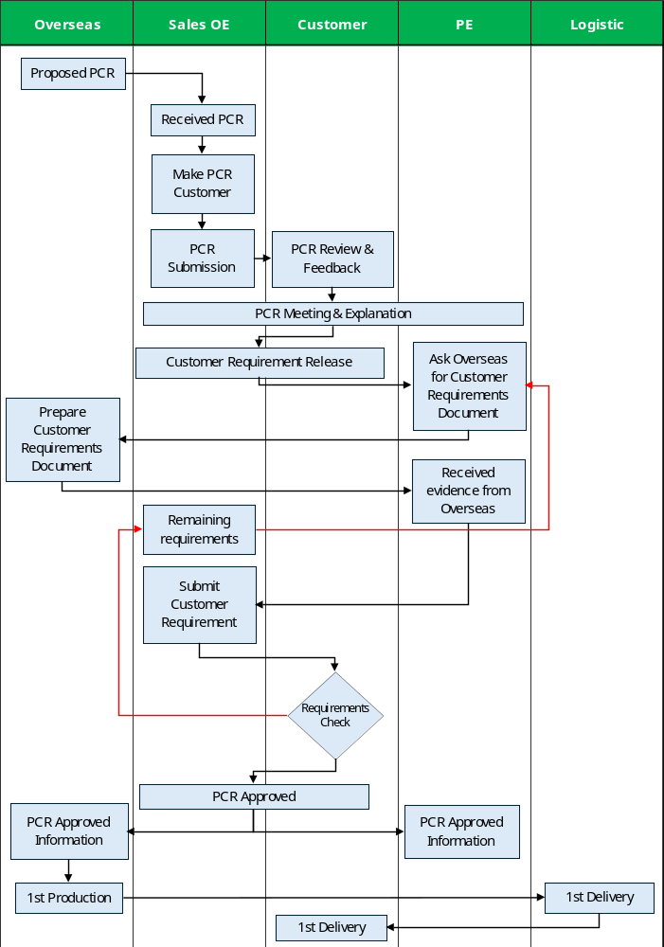
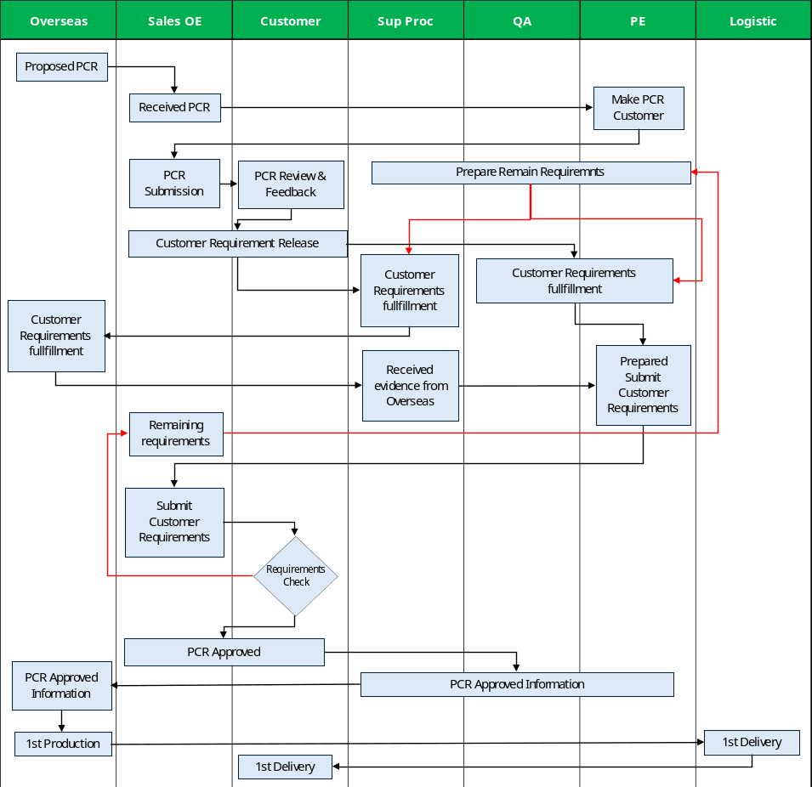
Appendix 3. Current Detail Process Pass Thru
Passthrough Part Model 1
Passthrough Part Model 2
Passthrough Part Model 3
Sample Case (That PE Know) :
1. AHM - Spark Plug : Additional Source, Production Change (Plating, Welding Tip Process)
2. AHM - Sensor Oxygen : Production Site Change
Sample Case (That PE Know) :
1. SIM 4W - Sensor Knock : Company Name Change from Wells Vehicle to Niterra North America
Sample Case (That PE Know) :
1. Honda 4W - Sensor Oxygen : New Glass Tube Application
2. SIM 4W - Sensor Knock : Change Source from Japan to Wells Vehicle
3. Honda 2W - Sensor Oxygen : Change dimension
4. etc
Notes:
1) Cross check sekali lagi terkait current existing

Slide 10
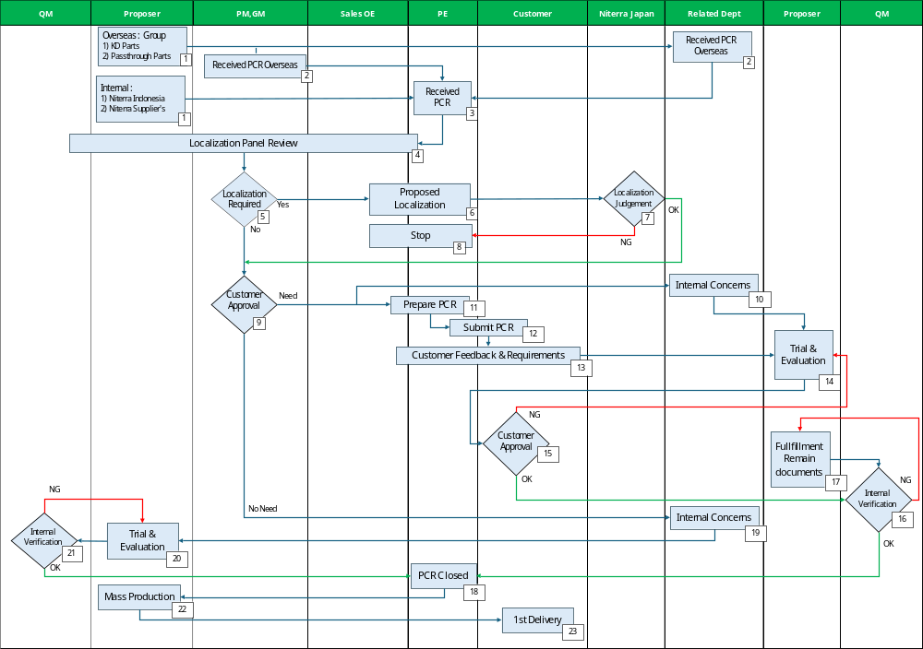
Appendix 4. Flow Process PCR Proposed
Definition of Proposer
Department that conduct the change

